Slide 1
CS 7375 Artificial Intelligence Spring 2022 Instructor: Xinyue Zhang
Lecture 1

Slide 2

Introduce Myself
Xinyue Zhang
Email: xzhang48@kennesaw.edu
Room: R2-311
Office Hour: Tuesday and Thursday 15:30-17:00 (f2f or Teams)
Zhang is pronounced as “John + g”, with the J in John pronounced like the Bonjour “zh” sound, in French.
Tip: tongue is curled back to gently touch the roof of your mouth very far back, well behind the ridge of your gums.

Slide 3
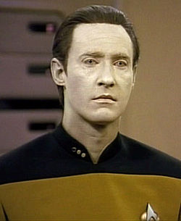
What is artificial intelligence (AI)?
Popular conception driven by science fiction
Robots good at everything except emotions, empathy, appreciation of art, culture, …
Perhaps more representative of human autism than of (current) real robotics/AI
“It is my belief that the existence of autism has contributed to [the theme of the intelligent but soulless automaton] in no small way.” [Uta Frith (German Psychologist), “Autism”]

Slide 4
Real AI
A serious science.
General-purpose AI like the robots of science fiction is incredibly hard
Human brain appears to have lots of special and general functions, integrated in some amazing way that we really do not understand at all (yet)
Special-purpose AI is more doable (nontrivial)
E.g., chess/poker playing programs, logistics planning, automated translation, voice recognition, web search, data mining, medical diagnosis, keeping a car on the road, … … … …

Slide 5
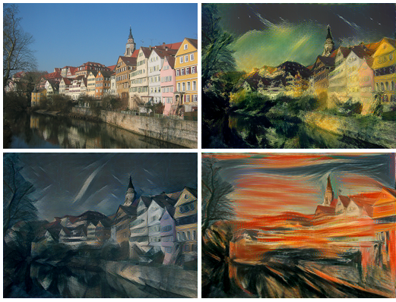
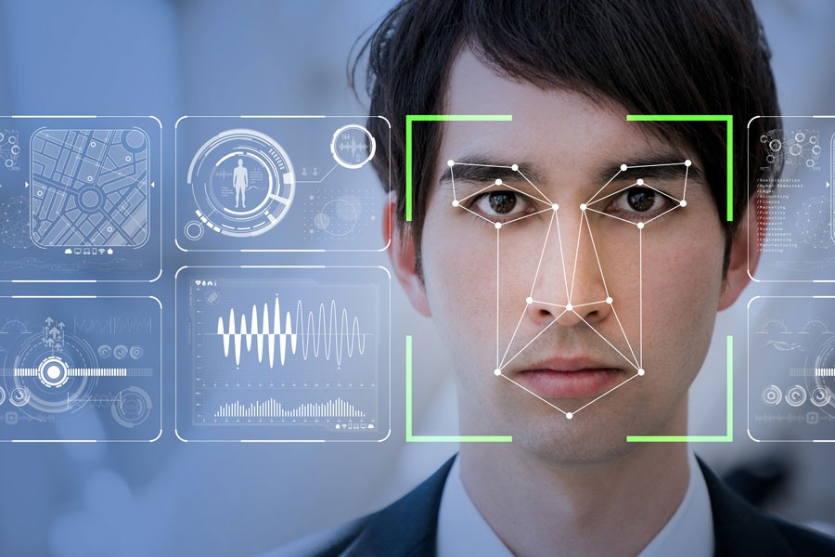
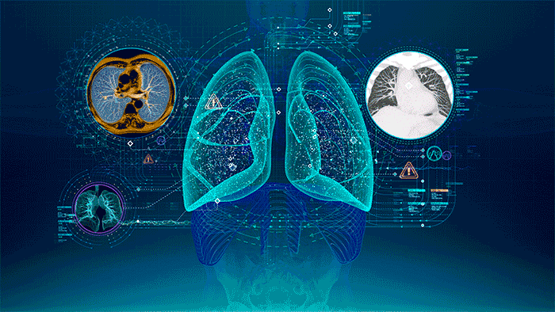
Real-World Applications
Medical Diagnosis
Face recognition
Generative Adversarial Networks

Slide 6

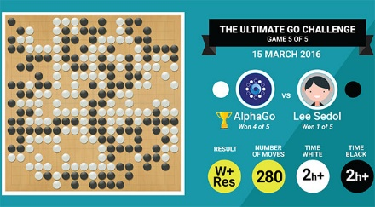


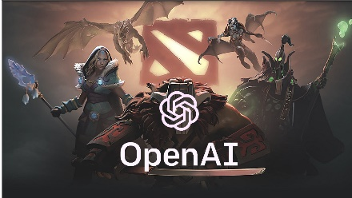
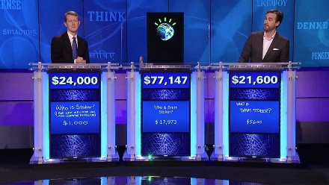
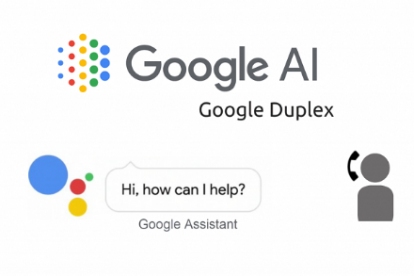
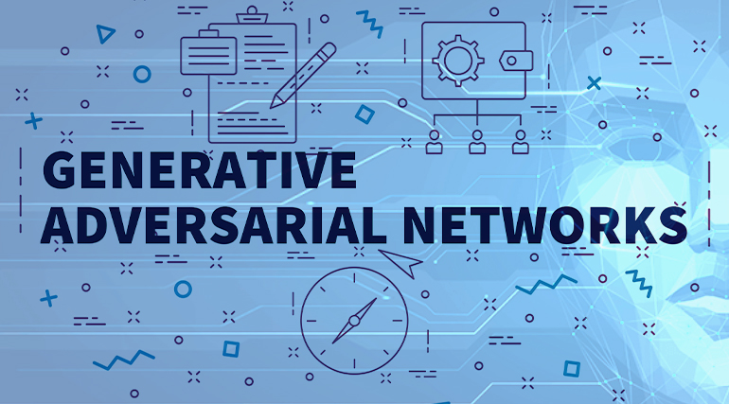
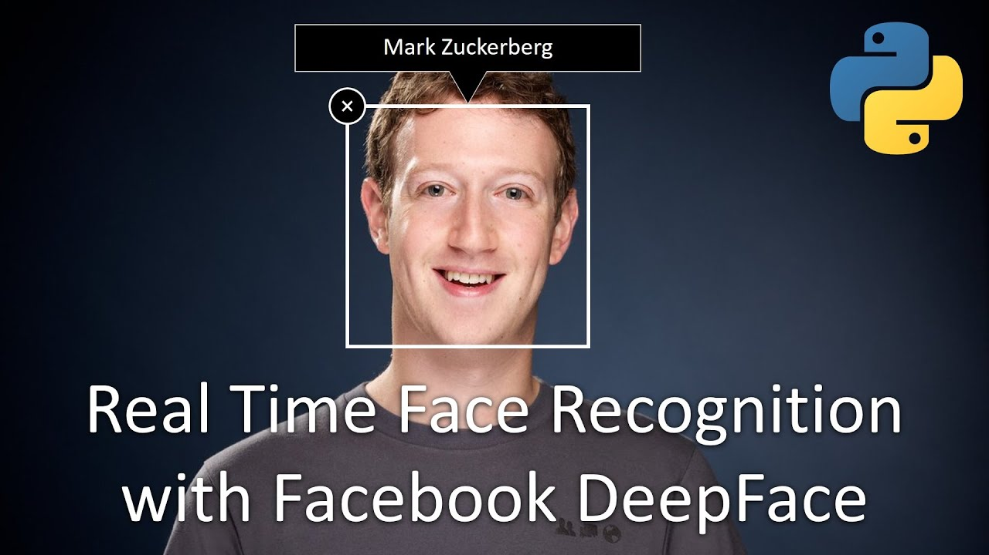
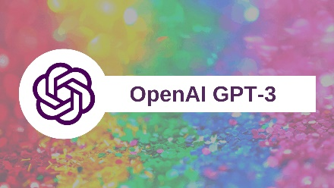
AI Evolution (Last Decade)
2009
2016
2010
2017
2011
2018
2014
2020

Slide 7
IBM Watson (2011)
Watson is a Question answering (QA) computing system.
IBM describes it as "an application of advanced Natural Language Processing, Information Retrieval, Knowledge Representation and Reasoning, and Machine Learning technologies to the field of open domain question answering"
Access to 200 million pages of structured and unstructured content consuming four terabytes of disk storage including the full text of Wikipedia.

Slide 8
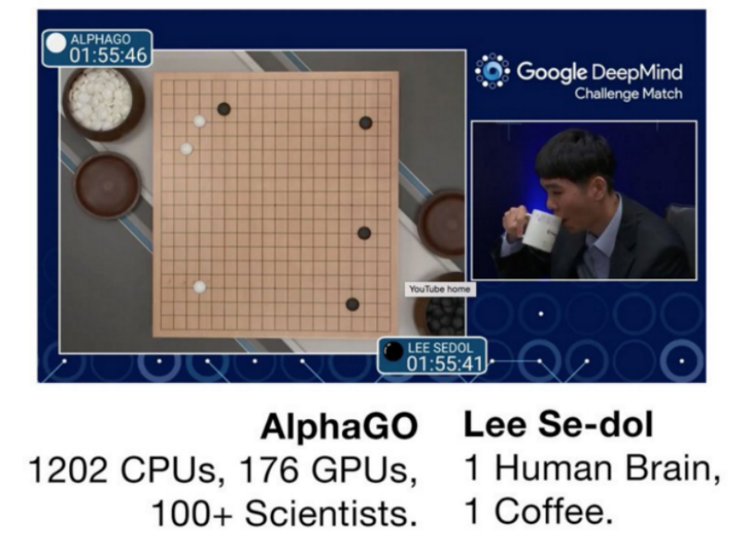
AlphaGo (2016)

Slide 9
AlphaGo (2016)
To begin, AlphaGo took 150,000 games played by good human players and used an artificial neural network (ANN) to find patterns in those games. In particular, it learned to predict with high probability what move a human player would take in any given position.
AlphaGo’s designers then improved the neural network by repeatedly playing it against earlier versions of itself, adjusting the network so it gradually improved its chance of winning.

Slide 10
Dota2 AI – OpenAI Five (2016-2019)
Each OpenAI Five network contains a single layer with a 4096-unit Long short-term memory, an artificial recurrent neural network (RNN), that observes the current game state extracted from the Dota developer's API.
The Dota 2 AI, called OpenAI Five, learned by playing over 10,000 years of games against itself.
It demonstrated the ability to achieve expert-level performance, learn human–AI cooperation, and operate at internet scale.

Slide 11
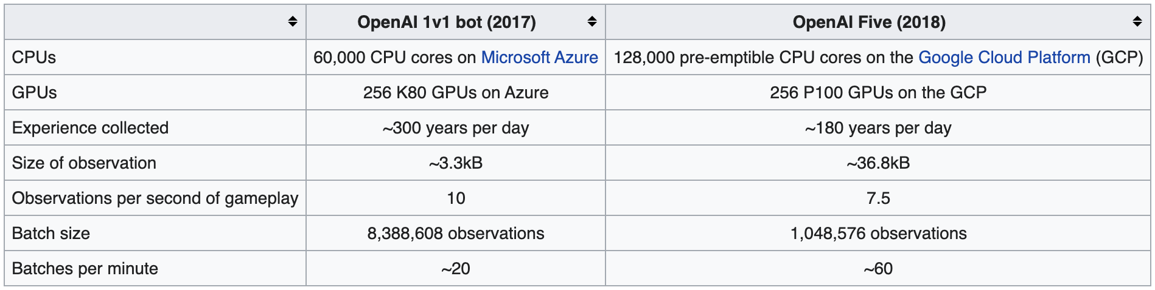
Dota2 AI – OpenAI Five (2016-2019)

Slide 12
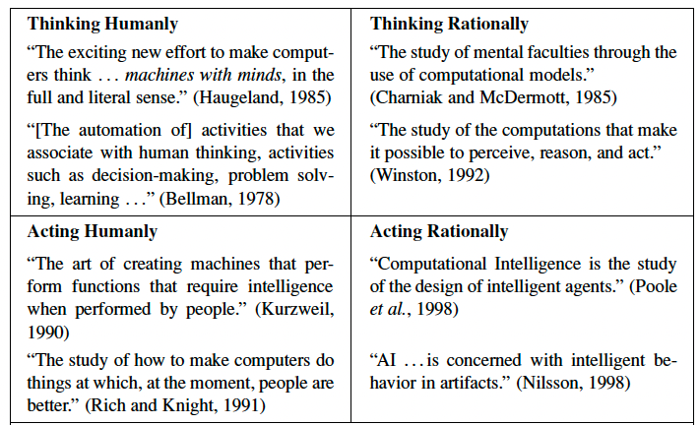
Definitions of AI
Thought
Processes
Behavior

Slide 13
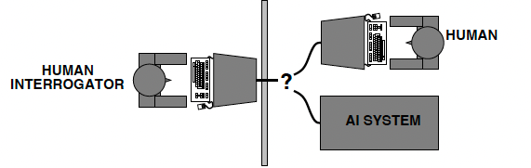
Acting Humanly: The Turing Test
Turing (1950) “Computing machinery and intelligence”:
Can machines think? → Can machines behave intelligently?"
Operational test for intelligent behavior: the Imitation Game
Predicted that by 2000, a machine might have a 30% chance of fooling a lay person for 5 minutes.
Problem: Turing test is not reproducible, constructive, or amenable to mathematical analysis

Slide 14
Is Turing Test the right goal?
“Aeronautical engineering texts do not define the goal of their field as making ‘machines that fly so exactly like pigeons that they can fool even other pigeons.’” [Russell and Norvig]

Slide 15
Thinking Humanly: Cognitive Science
Requires scientific theories of internal activities of the brain
What level of abstraction? “Knowledge” or “circuits”?
How to validate? Requires:
1) Predicting and testing behavior of human subjects (top-down)
or 2) Direct identification from neurological data (bottom-up)
Both approaches (roughly, Cognitive Science and Cognitive Neuroscience) are now distinct from AI.
The available theories do not explain anything resembling human-level general intelligence.

Slide 16
Thinking Rationally: Laws of Thought
The Greek philosopher Aristotle was one of the first to attempt to codify “right thinking”.
Several Greek schools developed various forms of logic:
notation and rules of derivation for thoughts;
may or may not have proceeded to the idea of mechanization
Problems:
1) Not all intelligent behavior is mediated by logical deliberation
2) What is the purpose of thinking? What thoughts should I have
out of all the thoughts (logical or otherwise) that I could have?

Slide 17
Acting Rationally
Rational behavior: doing the right thing
The right thing: which is expected to maximize goal achievement, given the available information
Doesn't necessarily involve thinking, but thinking should be in the service of rational action

Slide 18
Definitions of AI
if our system can be more rational than humans in some cases, why not?
Systems that think like humans | Systems that think rationally
Systems that act like humans | Systems that act rationally
focus on action avoids philosophical issues such as “is the system conscious” etc.
We will follow “act rationally” approach
Distinction may not be that important
acting rationally/like a human presumably requires (some sort of) thinking rationally/like a human,
humans much more rational anyway in complex domains

Slide 19
Lessons from AI research
Clearly-defined tasks that we think require intelligence and education from humans tend to be doable for AI techniques
Playing chess, drawing logical inferences from clearly-stated facts, performing probability calculations in well-defined environments, …
Although, scalability can be a significant issue
Complex, messy, ambiguous tasks that come natural to humans (in some cases other animals) are much harder
Recognizing your grandmother in a crowd, drawing the right conclusion from an ungrammatical or ambiguous sentence, driving around the city, …

Slide 20
Lessons from AI research
Humans better at coming up with reasonably good solutions in complex environments
Humans better at adapting/self-evaluation/creativity (“My usual strategy for chess is getting me into trouble against this person… Why? What else can I do?”)

Slide 21
Course Policies
Please check the syllabus for details.

Slide 22

Email: xzhang48@kennesaw.edu
Teams: Xinyue Zhang (xzhang48)

